Slide 1

Create the Donor Recognition Page Sprint 31 – PBI 1126

Slide 2
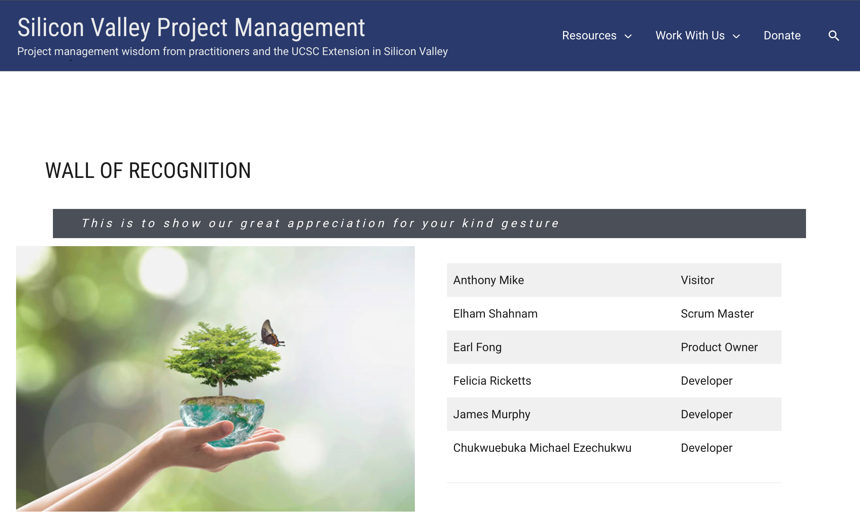
Goal
Using layout from PBI 1071 Implement the new tiered donations donor recognition page

Slide 3
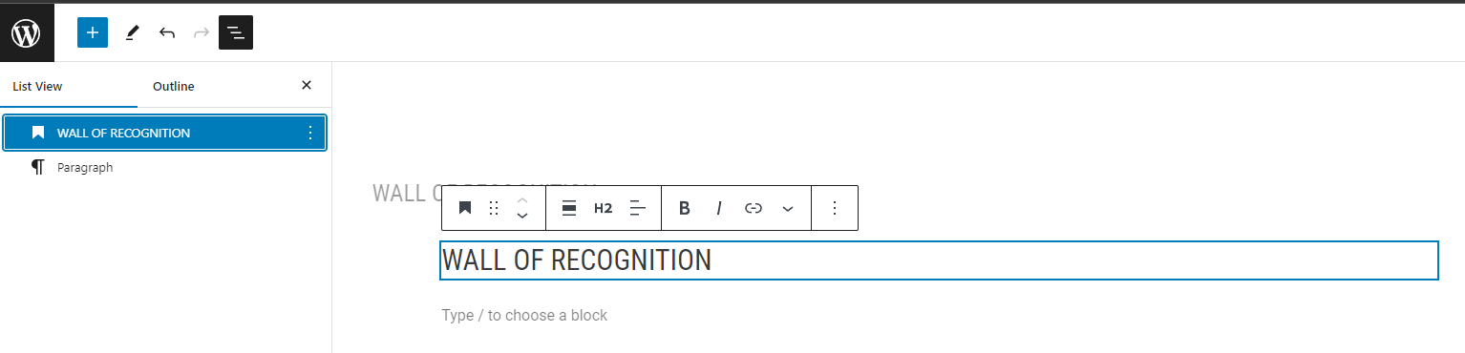
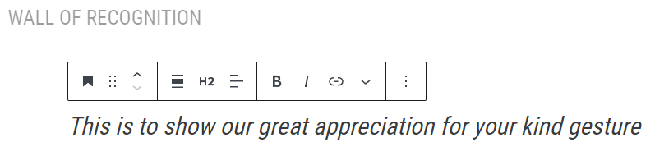
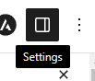
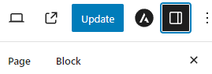
Steps – Creating Wall of Recognition Page
Create New Page
In WordPress and utilize layout of the screenshot in the Trello Card and create the page in WordPress
Header
Create a new page and add the header block (Wall of Recognition)
Next, create a new header and write "This is to show great appreciation for your kind gesture“
To edit the header, Click on settings on the top right-hand corner
This will open a menu on the right side of the screen, switch over to the block setting to edit the current header block

Slide 4
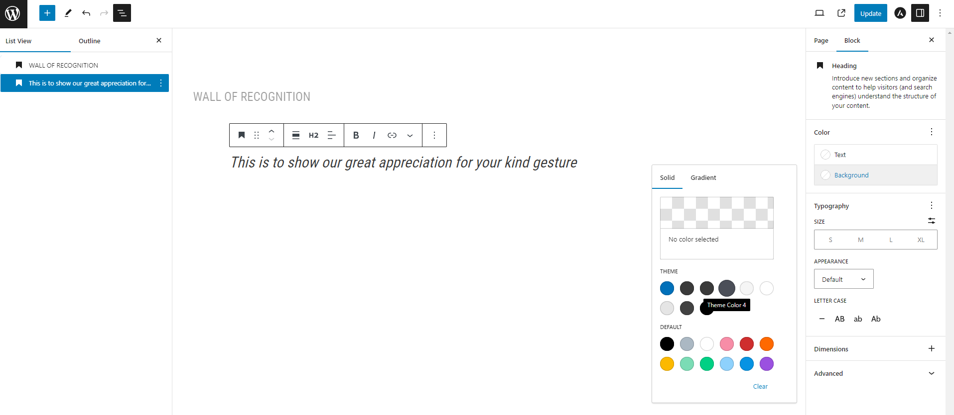

Steps – Creating Wall of Recognition Page
Using the block editor, Make the background dark grey and the text white to match the design.
Your header should look like this

Slide 5
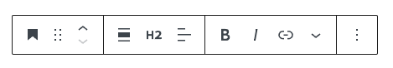
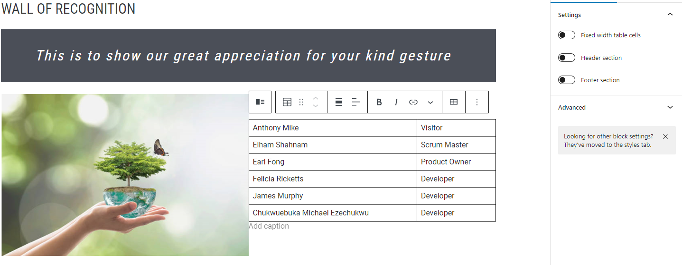
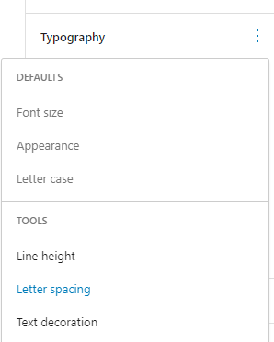
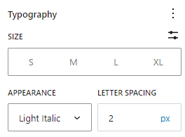
Steps – Creating Wall of Recognition Page
Next use the tool bar to adjust the text size to H2 & italicize text
Your header should look like this once you are done with it
Under typography editor select letter spacing.
Adjust letter spacing to 3.

Slide 6
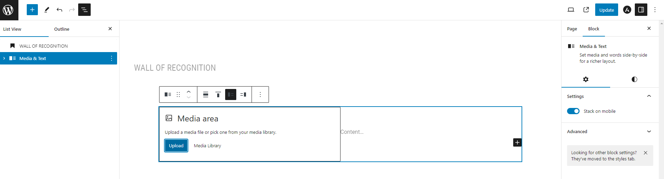
Steps – Creating Wall of Recognition Page
Create the media and text block under the header, In the media side, search media library and choose image. I chose an image that was provided to me from the team who built the layout.

Slide 7
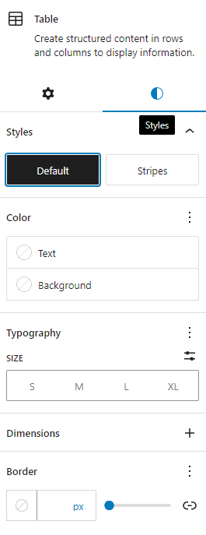
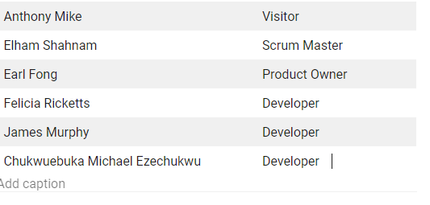
Steps – Creating Wall of Recognition Page
To edit Table settings –
Open styles menu.
Select stripes to achieve the alternating grey stripe color.
On the text side of the block create a table with the desired number of rows and columns and fill in names as provided.
(I used the names that were listed in the example)
Your table should look like this

Slide 8
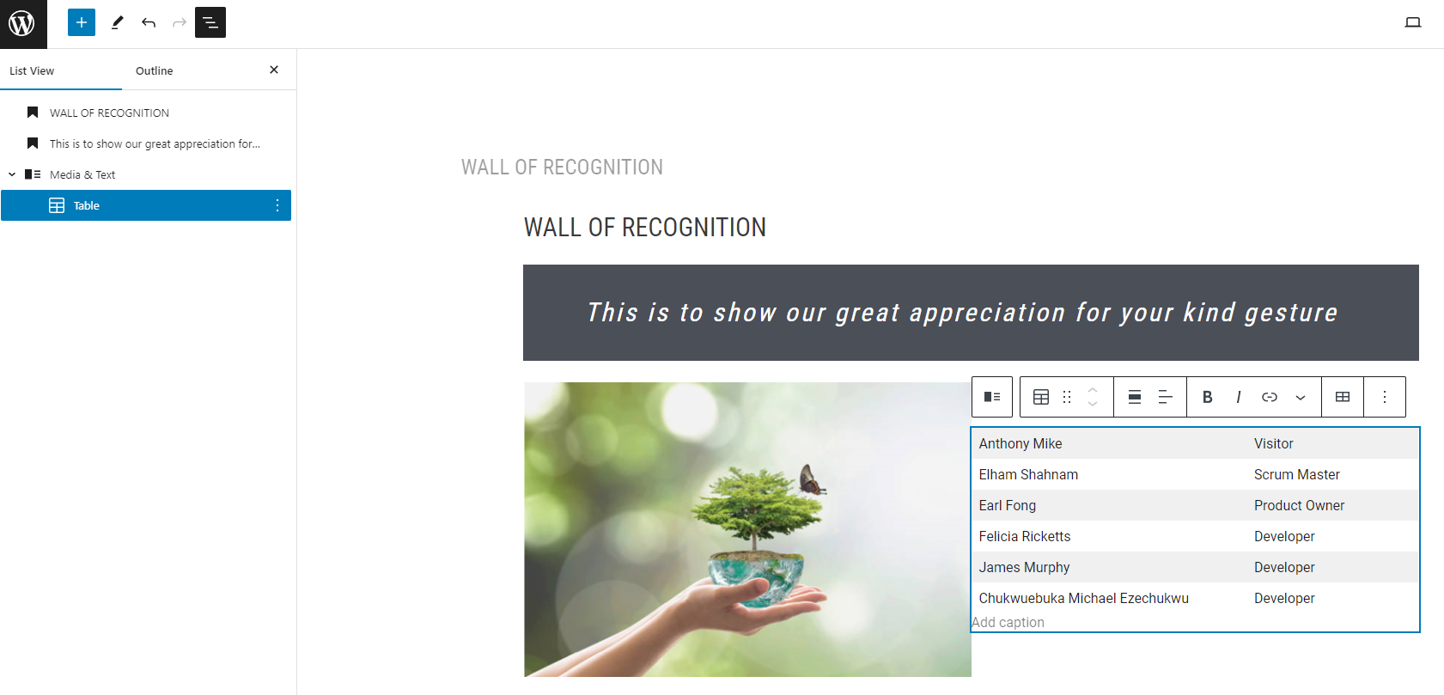
Steps – Creating Wall of Recognition Page
Once finished in development environment website and approved, will be moved to production environment.

Slide 9
Link to Wall of Recognition Page Ideas
Question from Trello Board – Where is the page going once in production?
Add a
Wall of Recognition
Button to Menu
Add under
Resources
dropdown
Add under
Donate
drop down

Slide 10
Reworking Menu Sprint 31 – PBI 1126

Slide 11
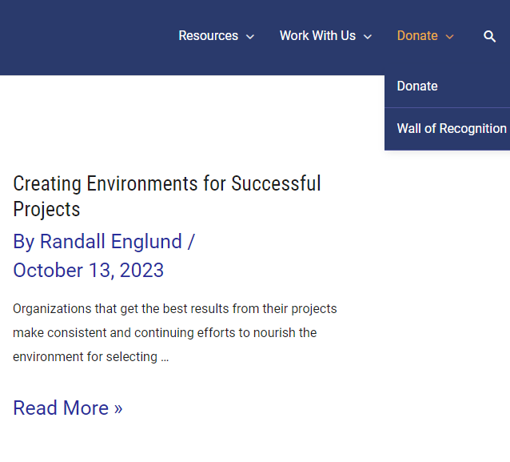
Goal
In Development Environment rework the Menu on home page to have donate drop down and have Donate Page and new Wall of Recognition Page.

Slide 12
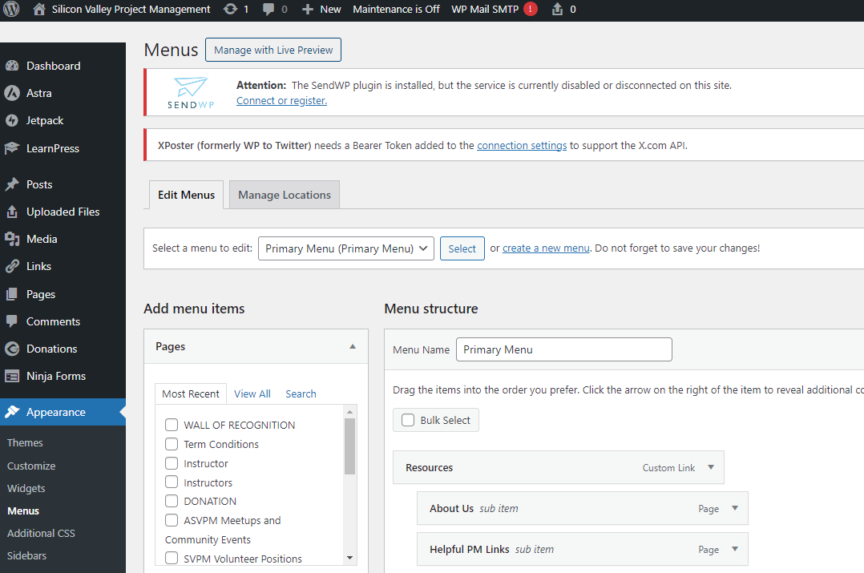
Steps – Updating Menu to Add Dropdown
Log into https://www.pmoleaders.com/wp-admin/
Website to build in development environment
In the menu on the right side of the page select the Appearance option
Select Menus
Click Manage with Live Preview button near the top of the page
This will take you to the editor

Slide 13
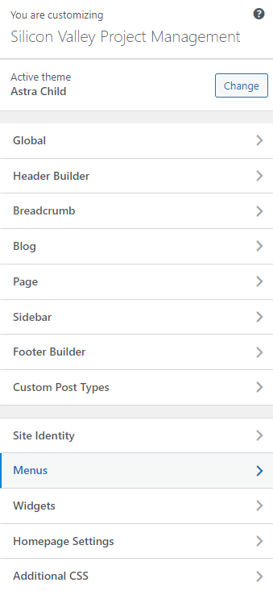
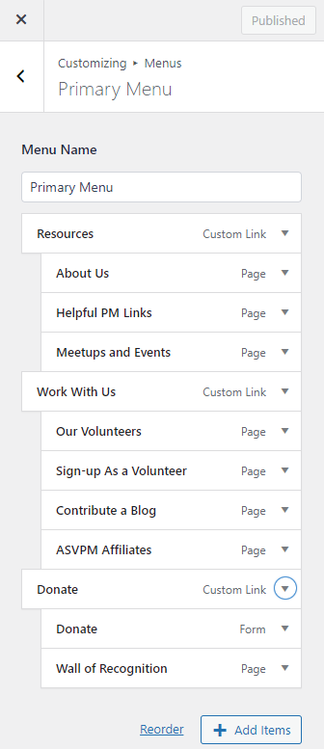
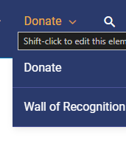
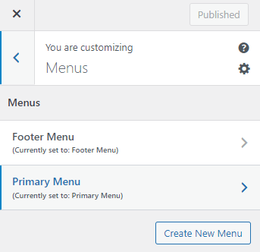
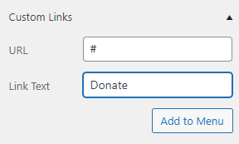
Steps – Updating Menu to Add Dropdown
Once in page Shift+Click on Menu items you want to Edit
Click Add Items at the bottom and it will bring up a side menu
Go to Custom Links to add the Donate menu that you will add the drop downs under – this does not currently need a URL. I copied the same format that the Resources page used and just added a # for the URL.
Name the Link Text Donate to create menu
Or select Menus in the sidebar and then select Primary Menu
Once in page Shift+Click on Menu items you want to Edit

Slide 14
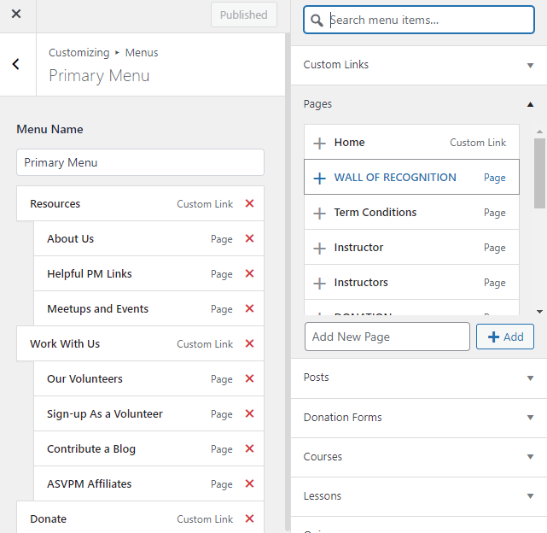
Steps – Updating Menu to Add Dropdown
Click Add Items and it will bring up a side menu with a list – select Pages
When Pages is selected, find the page that you created –
Wall of Recognition
Select Add

Slide 15
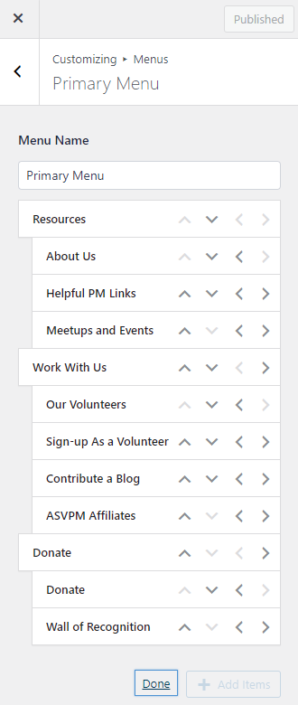
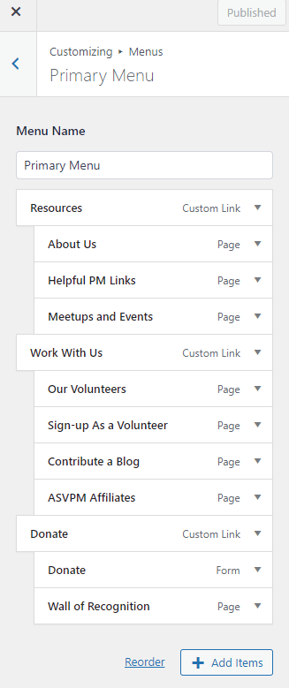
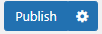
Steps – Updating Menu to Add Dropdown
Use the arrow buttons and ensure that they are listed under the Donate Custom Link
Once added click reorder (next to the Add Item Button) this will bring up arrows so you can move the order of each menu item.
Your menu order should look just like this:
Ensure that your Donate Custom Link as the main heading.
Use the Arrow Buttons to Reorder –
The Donate Custom Link should be first and aligned with the other main menu selections (Resources and Work With Us).
The Donate Form Page should be the first nested under Donate by clicking the Right Arrow .
The Wall of Recognition Page should be the second nested
under Donate.
Make sure to click Publish once you are finished to save your work!

Slide 16
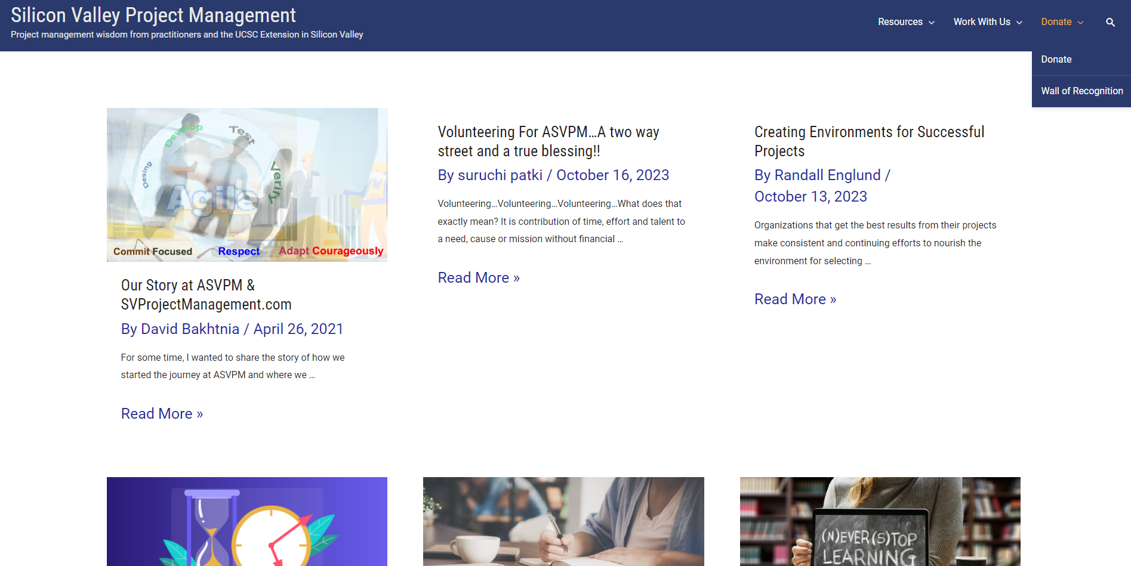
Steps – Updating Menu to Add Dropdown
Check your work on the live website and ensure everything displays properly and that all links function correctly. You should see the Donate Dropdown with the link to the Donate Page and then the Wall of Recognition.

Slide 17
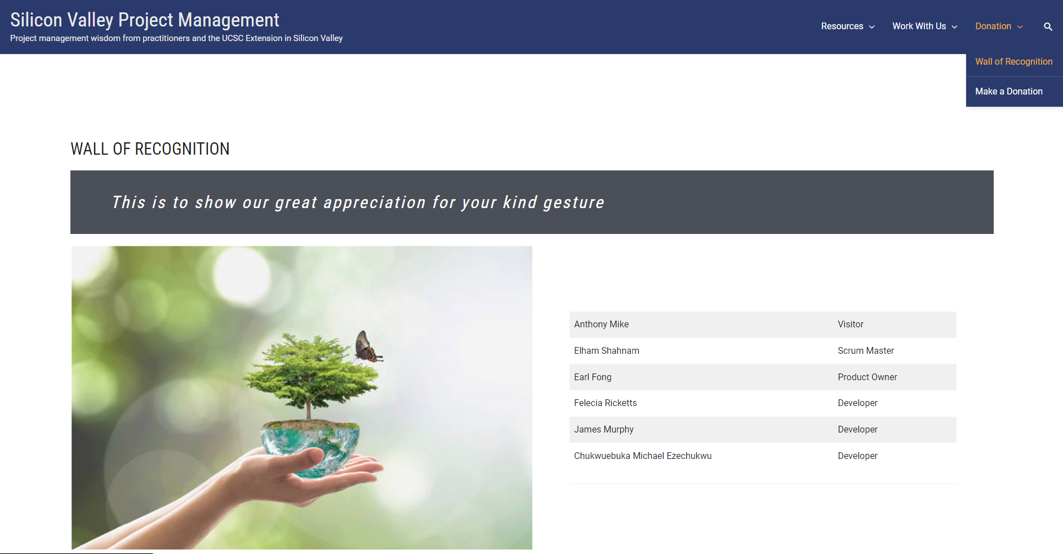
Steps – Updating Names on Menu
Made a small edit to the menu –
Main Menu: Donation –
Drop Down: First: Make a Donation (Previously Donate – would link to the donation form)
Second: Wall of Recognition

